Slide 1
CSCI 6461: Computer Architecture
MIPS
Instructor: M. Lancaster
Contains slides from Morgan Kaufmann Publishers annotated by M. Lancaster

Slide 2
MIPS

Slide 3
The Processor: Datapath & Control
We're ready to look at an implementation of the MIPS
Simplified to contain only:
  memory-reference instructions: lw, sw
  arithmetic-logical instructions: add, sub, and, or, slt
  control flow instructions: beq, j
Generic Implementation:
  use the program counter (PC) to supply instruction address
  get the instruction from memory
  read registers
  use the instruction to decide exactly what to do
All instructions use the ALU after reading the registers
Why? memory-reference? arithmetic? control flow?

Slide 4
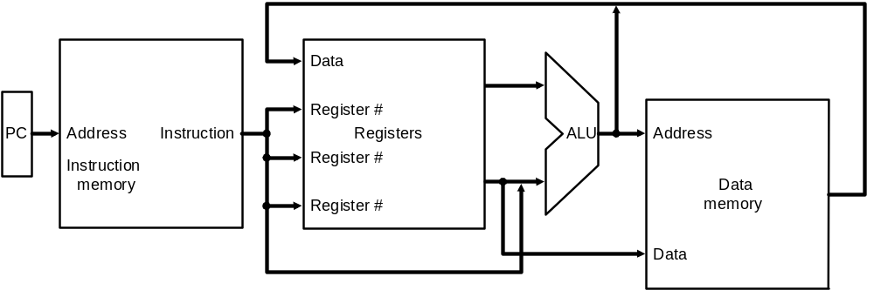
More Implementation Details
Abstract / Simplified View:
Two types of functional units:
  elements that operate on data values (combinational)
  elements that contain state (sequential)

Slide 5
State Elements
Unclocked vs. Clocked
Clocks used in synchronous logic
  when should an element that contains state be updated?
falling edge
cycle time
rising edge

Slide 6
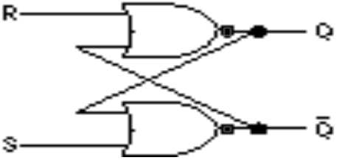
An unclocked state element
The set-reset latch
  output depends on present inputs and also on past inputs

Slide 7
Latches and Flip-flops
Output is equal to the stored value inside the element
(don't need to ask for permission to look at the value)
Change of state (value) is based on the clock
Latches: whenever the inputs change, and the clock is asserted
Flip-flop: state changes only on a clock edge
(edge-triggered methodology)
"logically true",
— could mean electrically low
A clocking methodology defines when signals can be read and written
— wouldn't want to read a signal at the same time it was being written

Slide 8
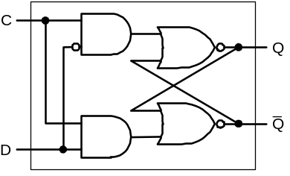
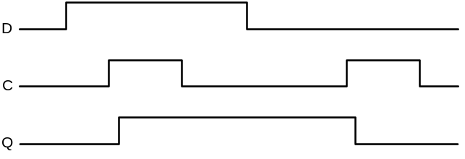
D-latch
Two inputs:
  the data value to be stored (D)
  the clock signal (C) indicating when to read & store D
Two outputs:
  the value of the internal state (Q) and it's complement

Slide 9
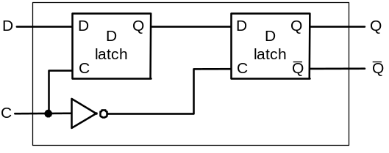
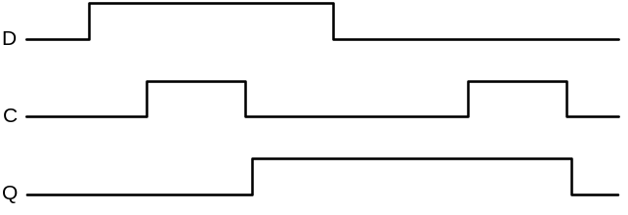
D flip-flop
Output changes only on the clock edge

Slide 10
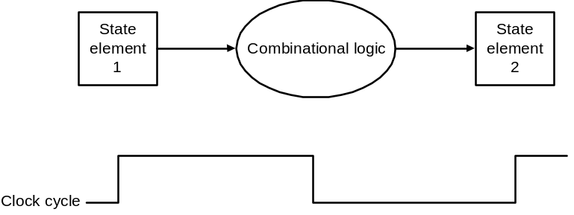
Our Implementation
An edge triggered methodology
Typical execution:
  read contents of some state elements,
  send values through some combinational logic
  write results to one or more state elements

Slide 11
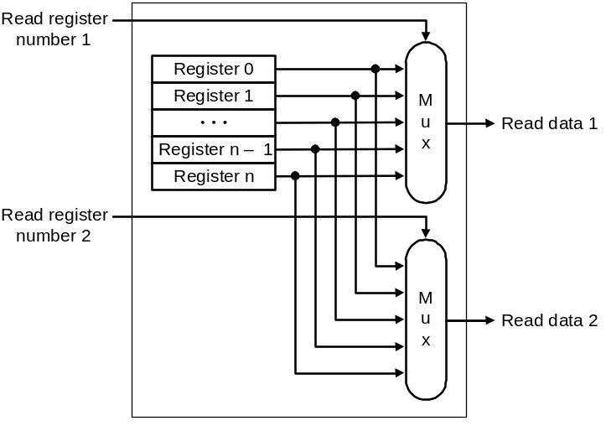
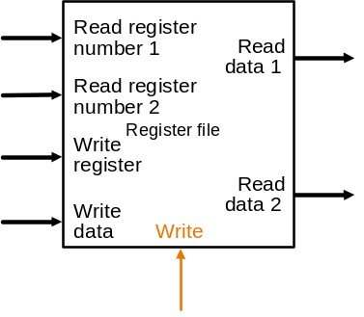
Register File
Built using D flip-flops

Slide 12
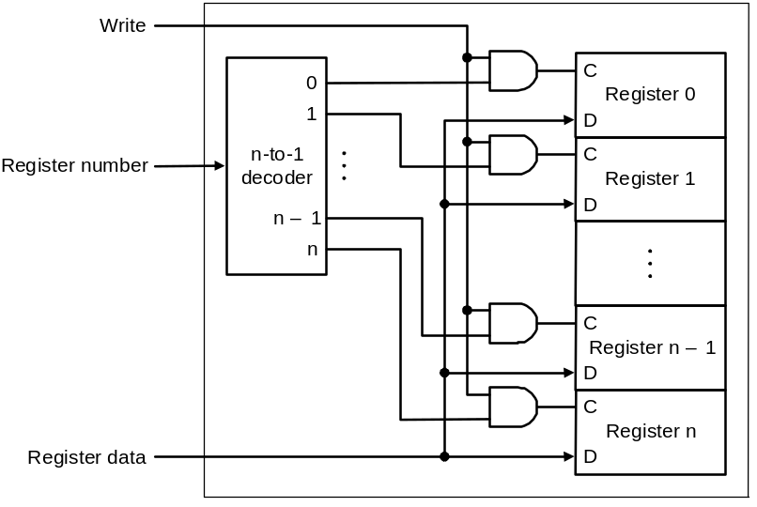
Register File
Note: we still use the real clock to determine when to write

Slide 13
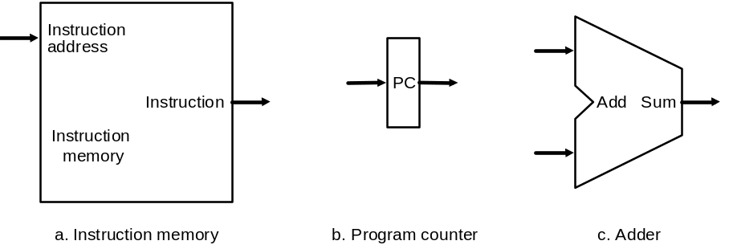
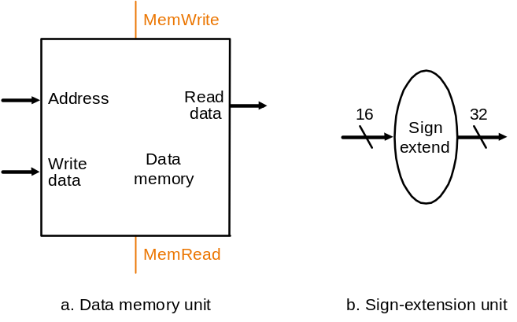
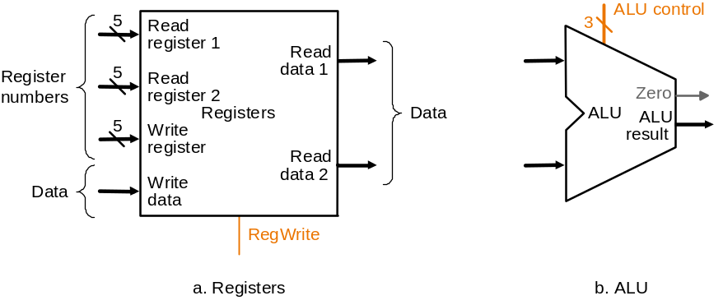
Simple Implementation
Include the functional units we need for each instruction
Why do we need this stuff?

Slide 14
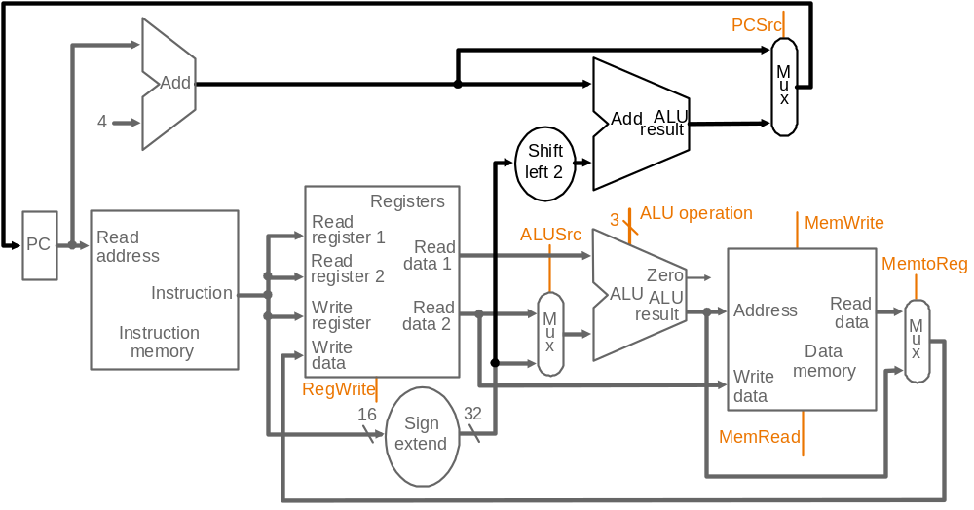
Building the Datapath
Use multiplexors to stitch them together

Slide 15
Control
Selecting the operations to perform (ALU, read/write, etc.)
Controlling the flow of data (multiplexor inputs)
Information comes from the 32 bits of the instruction
Example:
add $8, $17, $18 Instruction Format:
000000 10001 10010 01000 00000 100000
op rs rt rd shamt funct
ALU's operation based on instruction type and function code

Slide 16
Control
e.g., what should the ALU do with this instruction
Example: lw $1, 100($2)
35 2 1 100
op rs rt 16 bit offset
ALU control input
000 AND
001 OR
010 add
110 subtract
111 set-on-less-than

Slide 17
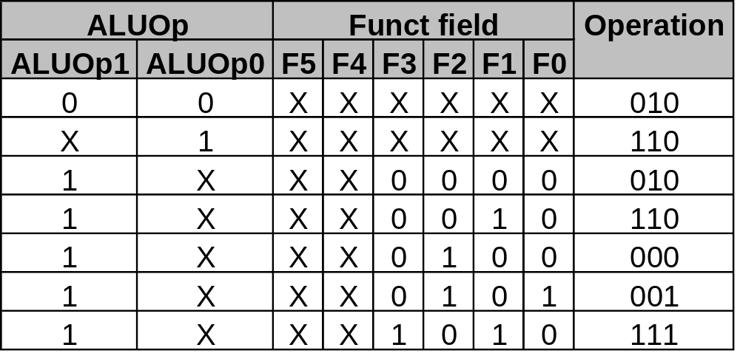
Control
Must describe hardware to compute 3-bit ALU conrol input
  given instruction type
  00 = lw, sw
  01 = beq,
  11 = arithmetic
  function code for arithmetic
Describe it using a truth table (can turn into gates):
ALUOp
computed from instruction type

Slide 18
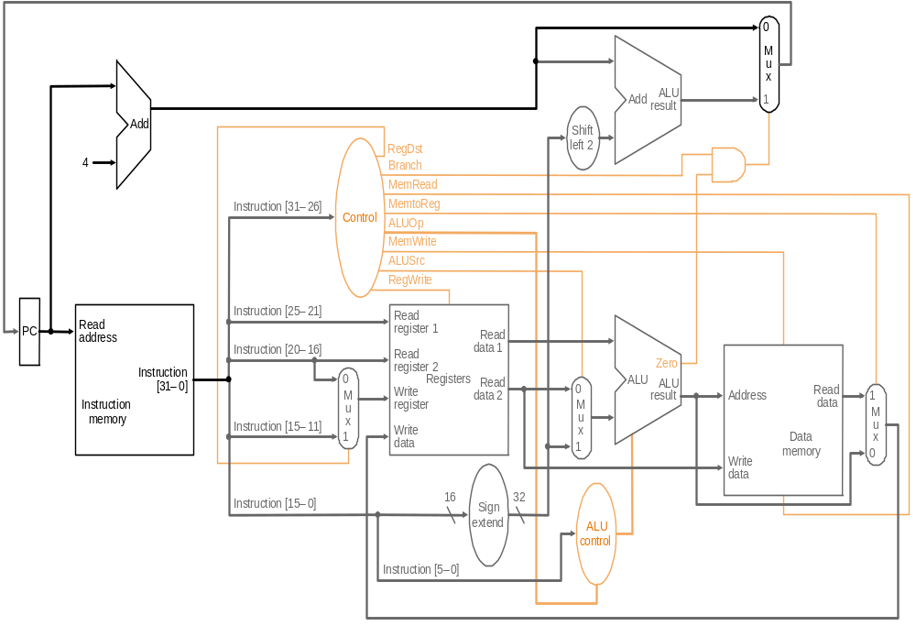
Control

Slide 19
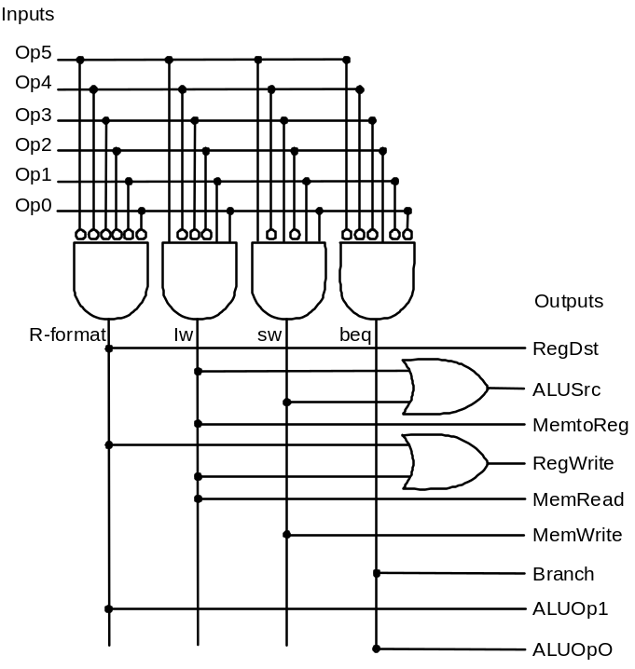
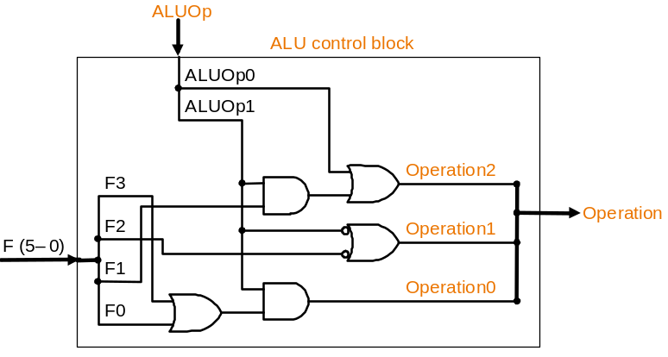
Control
Simple combinational logic (truth tables)

Slide 20
Our Simple Control Structure
All of the logic is combinational
We wait for everything to settle down, and the right thing to be done
  ALU might not produce “right answer” right away
  we use write signals along with clock to determine when to write
Cycle time determined by length of the longest path
We are ignoring some details like setup and hold times

Slide 21
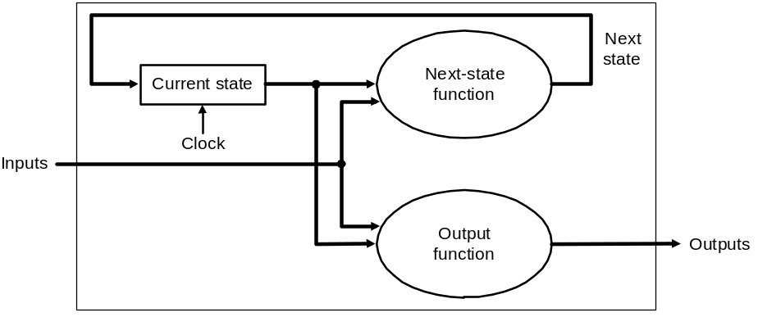
Review: finite state machines
Finite state machines:
  a set of states and
  next state function (determined by current state and the input)
  output function (determined by current state and possibly input)
  We’ll use a Moore machine (output based only on current state)

Slide 22
Multicycle Approach
Break up the instructions into steps, each step takes a cycle
  balance the amount of work to be done
  restrict each cycle to use only one major functional unit
At the end of a cycle
  store values for use in later cycles (easiest thing to do)
  introduce additional “internal” registers

Slide 23
Five Execution Steps
Instruction Fetch
Instruction Decode and Register Fetch
Execution, Memory Address Computation, or Branch Completion
Memory Access or R-type instruction completion
Write-back step
INSTRUCTIONS TAKE FROM 3 - 5 CYCLES!

Slide 24
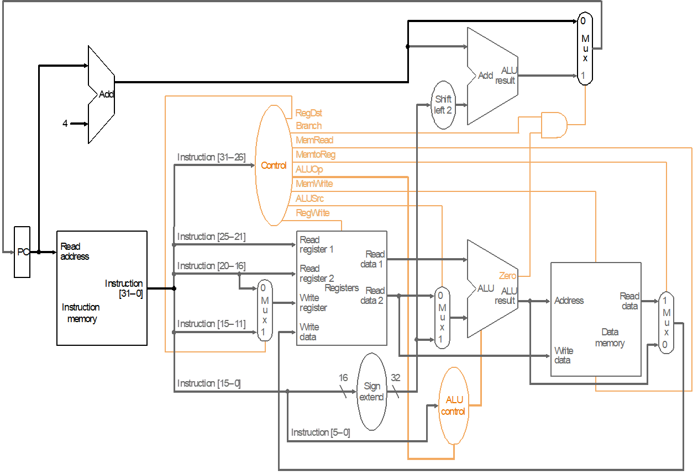
Step 1: Instruction Fetch
Use PC to get instruction and put it in the Instruction Register.
Add 4 to the PC and make that value available for selection.
Instruction = Memory[PC];
PCAdderOut = PC + 4;

Slide 25
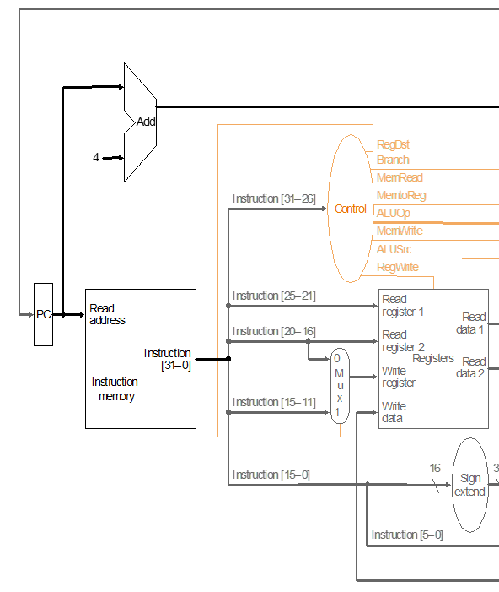
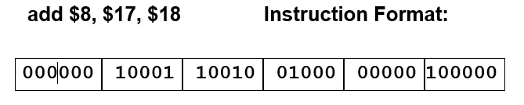
Step 1: Instruction Fetch – detail of content
00000044
00000040
02324020

Slide 26
Step 2: Instruction Decode and Register Fetch
Read registers rs and rt in case we need them
Compute the branch address in case the instruction is a branch
Readdata1 = Reg[IR[25-21]];
Readdata2 = Reg[IR[20-16]];
Since inputs are available AddAluResult = PCAdderOut +
sign-extend(IR[15-0])<<2;
We aren't setting any control lines based on the instruction type
(we are busy "decoding" it in our control logic)
PCAdderOut

Slide 27
Step 2: Instruction Decode – detail of content
00000044
0 - 000000
17 - 100001
00000040
18 - 10010
8 - 01000
02324020
0 - 01000
0 - 00000
32 - 100000
4020

Slide 28
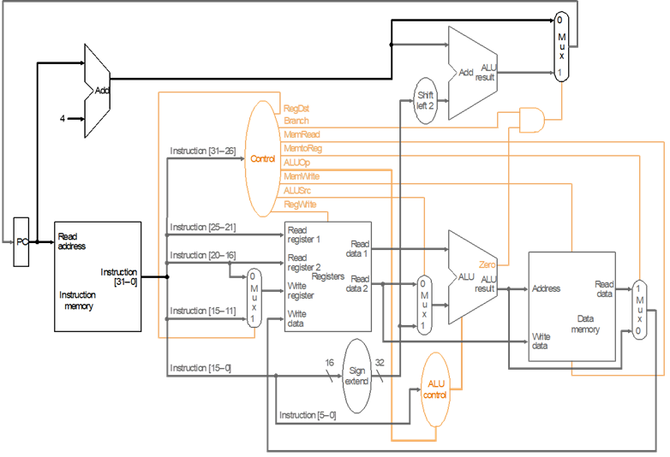
Step 3 (instruction dependent) Execute
ALU is performing one of three functions, based on instruction type
Memory Reference: ALUresult = Readdata1 + sign-extend(IR[15-0]);
R-type: ALUresult = Readdata1 op Readdata2;
Branch: if (Readdata1==Readdata2*) PC = AdderALUResult else PC = PCAdderOut note that mux does this, simulate the mux (muxout = Branch and Zero Flag)
*Readdata1==Readdata2 is determined in the ALU by subtracting. If they are the same then the Zero flag

Slide 29
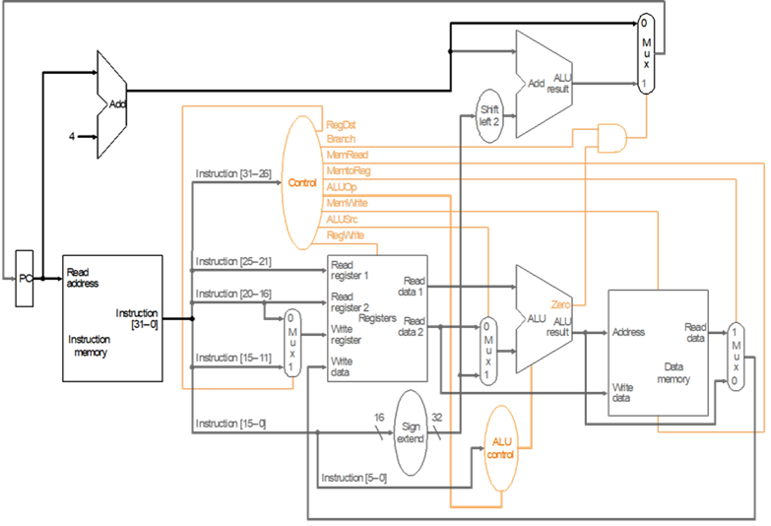
Step 4 (R-type or memory-access)
Loads and stores access memory
Data Memory Readdata = Memory[ALUresult]
Memory[ALUresult] = Readdata2; simulate the mux
R-type instructions finish
Reg[IR[15-11]] = ALUResult; simulate the mux

Slide 30
Write-back step
Note that this step only occurs for memory read. The mux goint into the register file WriteRegister input determines which bits of the instruction to take.
Reg[IR[20-16]]= ReadData output of memory, again simulate that mux and the mux feeding the register file.

Slide 31
Implementing the Control
Value of control signals is dependent upon:
  what instruction is being executed
  which step is being performed
Implementation can be derived from specification

